Slide 1

Motion Sensor Light
AUTOMATIC ON & OFF LIGHT
01

Slide 2


Components for Project :
1) CD4017 IC
2) LM358 IC
3) BC547 Transistor
4) 100uF 25V Capacitor
5) 1000uF 25V Capacitor
6) 220-ohm 0.25watt Resistors – 4 no
7) 10k 0.25watt Resistor
8) 10k Trimmer
9) LED 5mm – 2no
10) IR LED pair (Detector & Emitter)
11) 1N4007 Diode
12) 5V SPDT Relay
13) Connectors & IC Base
02

Slide 3

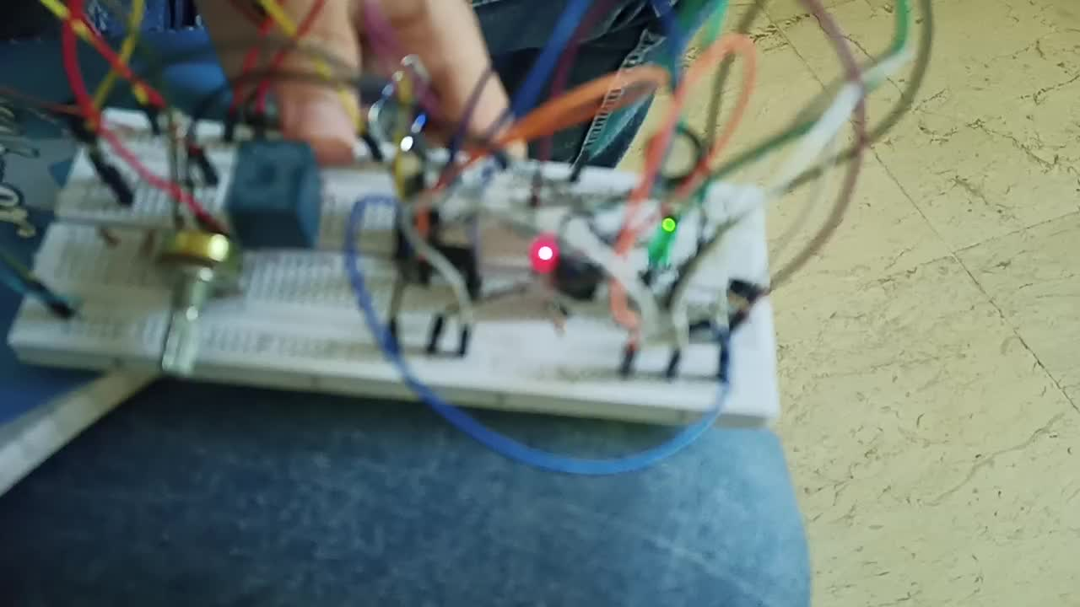
Video for circuit when it work :
03

Slide 4
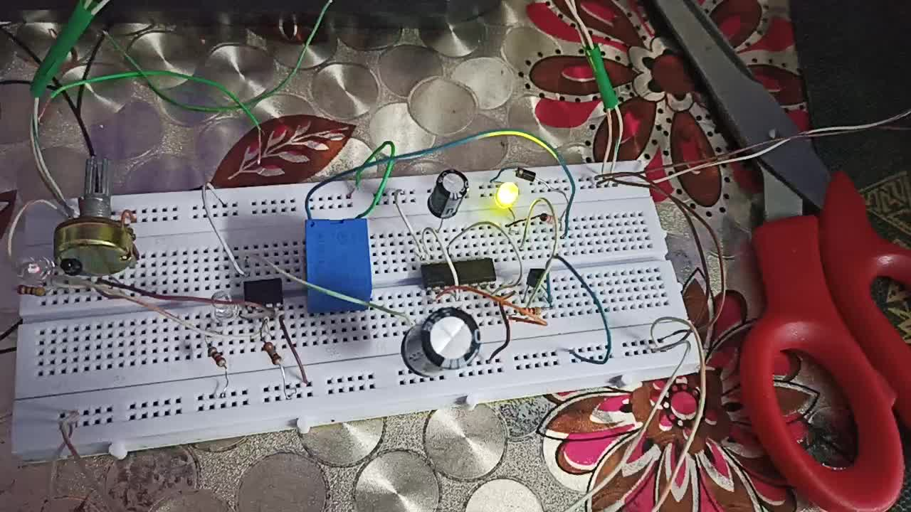
VIDEO FOR CIRCUIT WHEN IT WORK :
04

Slide 5

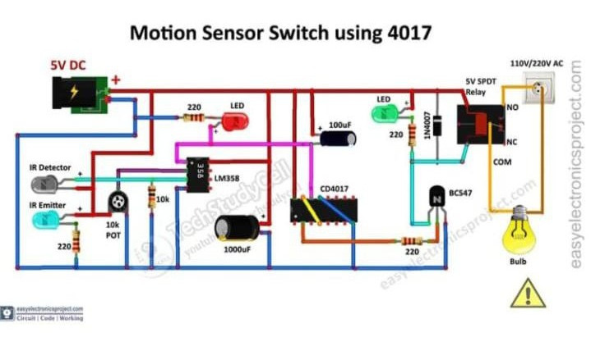
Circuit of the Motion Sensor Light:
05

Slide 6
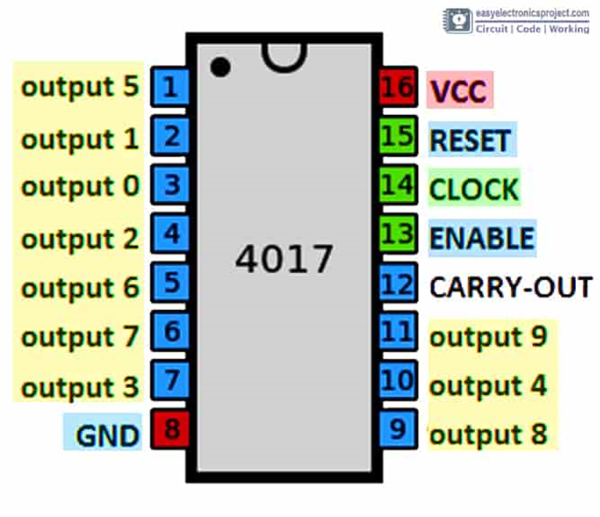
CD4017 PINOUT
06

Slide 7

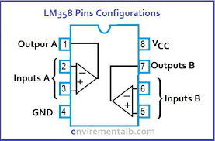
IC LM358
07

Slide 8



How the Motion Sensor Circuit works ?
1- THE IR EMITTER LED CONTINUOUSLY EMITS INFRARED. WHEN ANY OBJECT COMES WITHIN THE RANGE, SOME AMOUNT OF INFRARED REFLECTS FROM THE OBJECT’S SURFACE AND THAT REFLECTED INFRARED CAN BE DETECTED BY THE IR RECEIVER LED.
2- THE LM358 COMPARES THE VOLTAGE ACROSS THE IR RECEIVER LED WITH THE PREDEFINED VALUE. WHEN ANY MOTION IS DETECTED THE VOLTAGE ACROSS THE IR RECEIVER CROSSES THE PREDEFINED VALUE, SO THE OUTPUT PIN (PIN 1) OF LM358 BECOMES HIGH.
3- THE CLOCK PIN (PIN-14) OF CD4017 IC IS CONNECTED TO THE OUTPUT PIN OF LM358. SO WHEN ANY MOTION IS DETECTED, THE 4017 IC RECEIVES A CLOCK PULSE AND CHANGES THE CURRENT STATE OF PIN-2.
08

Slide 9


4- THE PIN-2 OF CD4017 IS CONNECTED WITH THE BASE OF THE BC547 NPN TRANSISTOR, SO WHEN THE PIN-2 BECOMES HIGH THE TRANSISTOR TURNS ON.
5- WHEN THE TRANSISTOR TURNS ON, THE CURRENT CAN FLOW THROUGH THE RELAY COIL. SO THE LOAD CONNECTED WITH THE RELAY ALSO TURNS ON.
6- WHEN THE IR LEDS DETECT ANY MOTION THE SECOND TIME, IT SENDS THE NEXT CLOCK PULSE TO CD4017 IC. THEN THE PIN-2 BECOMES LOW.
7- IF THE PIN-2 BECOMES LOW, THE TRANSISTOR TURNS OFF, AND ACCORDINGLY THE LOAD CONNECTED WITH THE RELAY ALSO TURNS OFF.
09

Slide 10
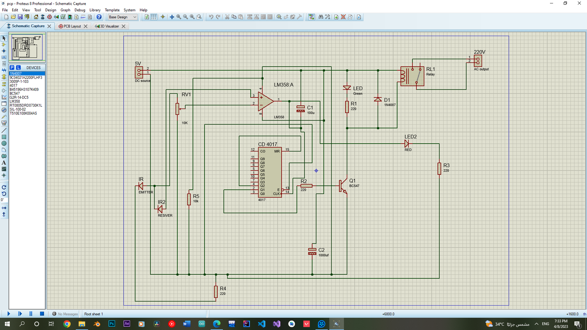
PCB LAYOUT OF THE MOTION SENSOR SWITCH:
10

Slide 11
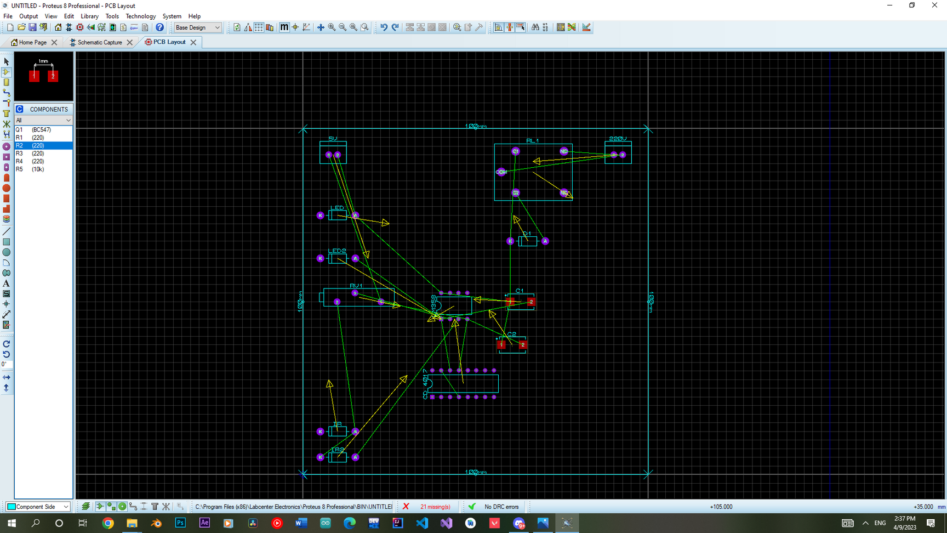
PCB LAYOUT OF THE MOTION SENSOR SWITCH:
11

Slide 12
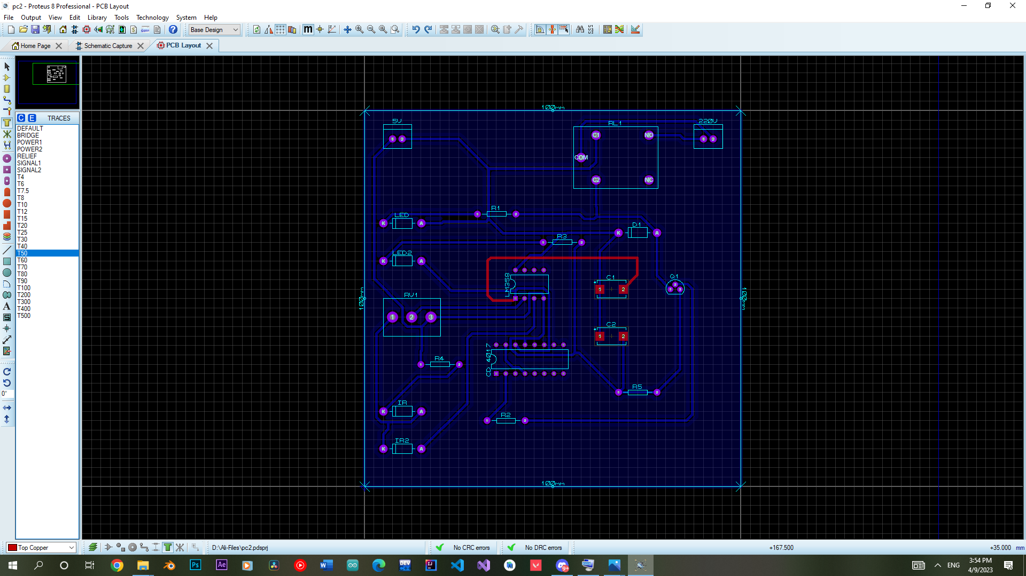
12

Slide 13
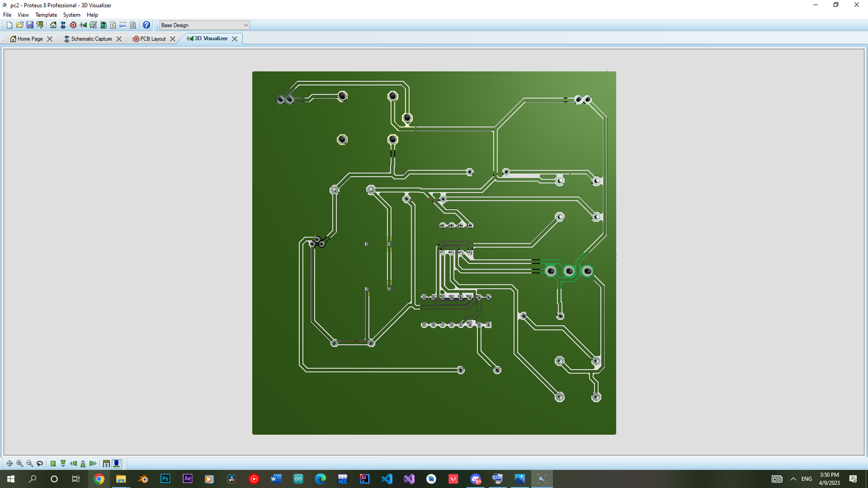
13
PCB LAYOUT OF THE MOTION SENSOR SWITCH:

Slide 14
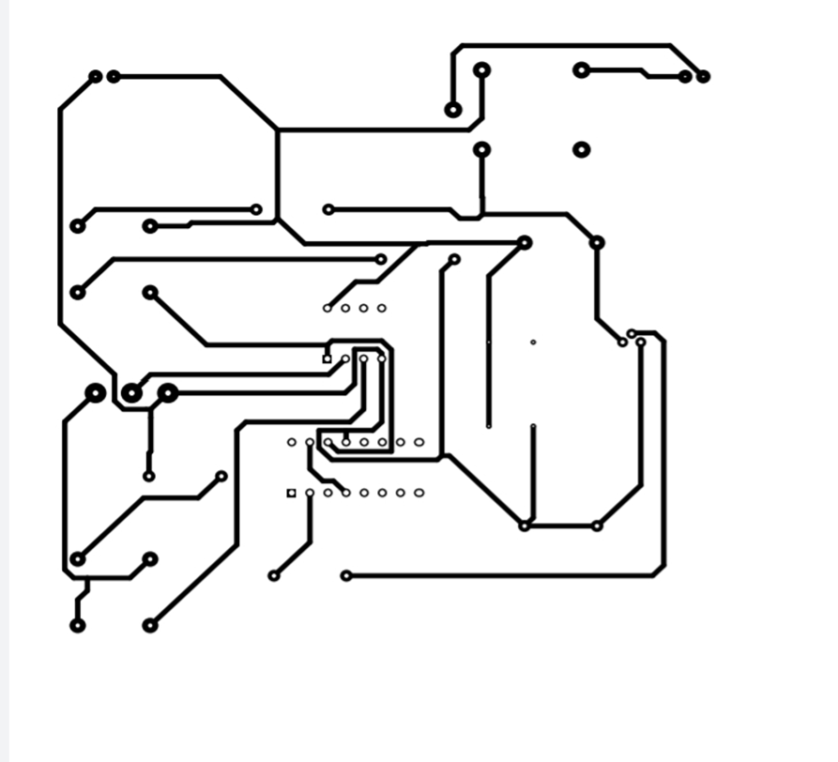
PCB LAYOUT OF THE MOTION SENSOR SWITCH:
14

Slide 15

عمل الطلاب:
- على عبدالمنعم على ابراهيم
- احمد زكريا عبدالعال يوسف
- رحمه احمد يوسف امين
- ايثار عدنان ابراهيم البليدي
- اسراء مجدي محمد نجيب
CREATIVE PORTFOLIO
15

